Slide 1
Week 1 Introduction to C++ and Array Data Structure
Tri A. Budiono
COMP6571 Data Structures and Algorithms
Even Semester 2020/2021

Slide 2
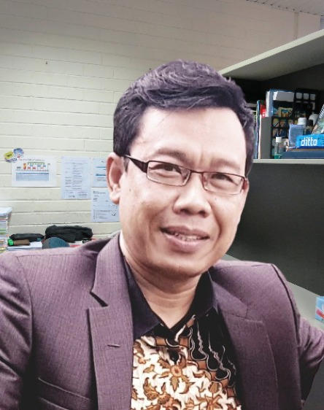
Lab Introduction
Course: COMP6571 Data Structures and Algorithms
Class: L2BC (Section B)
Lab Assistant
Ir. Tri Asih Budiono, MIT
Contact:
Whatsapp: 0812 1900 9192
Line: trirefardi

Slide 3
Weekly Topics
Week | Lecturing Topic | Lab Session | Lab Topic: Data Structures | Lab Topic: C++ Programming | Lab Topic: Algorithms
1 | Introduction to Data Structures, Design and Analysis of Algorithms | 1 |  | Object and Class
 |  | 2 | Array and Pointers
2 | Basic Data Types | 1 |  | Inheritance and Composition
 |  | 2 | List (Singly Linked-List, Doubly Linked-List)
3 | Stack | 1 |  | Template and Generic Programming
 |  | 2 | Stack, Double Linked-List
4 | Queue | 1 |  | Polymorphism
 |  | 2 | Queue, Circular Linked-List
5 | Tree | 1 | Partially ordered trees (Heap) and Binary Tree
 |  | 2 | BST
6 | Set | 1 | Hashtable
 |  | 2 | Priority Queue and Heap
7 | Advanced Set | 1 | Balanced Trees (AVL, 2-3 Tree and B-Tree)
 |  | 2 | Tries
8 | Directed Graph | 1 | Adjacency List, Adjacency Matrices |  | Traversal
 |  | 2 |  |  | SSP and ASP
9 | Undirected Graph | 1 | Adjacency List, Adjacency Matrices |  | MST
 |  | 2 |  |  | Matching
10 | Searching and Sorting | 1 |  |  | O(n2) sorting
 |  | 2 | Heap (partially ordered-tree) |  | Advanced Sorting
11 | Algorithm Analysis Techniques | 1 |  |  | Solving recurrence
 |  | 2 |  |  | Lower bound techniques
12 | Algorithm Design Techniques | 1 |  |  | DC, DP, Greedy, Backtracking, LS
 |  | 2

Slide 4

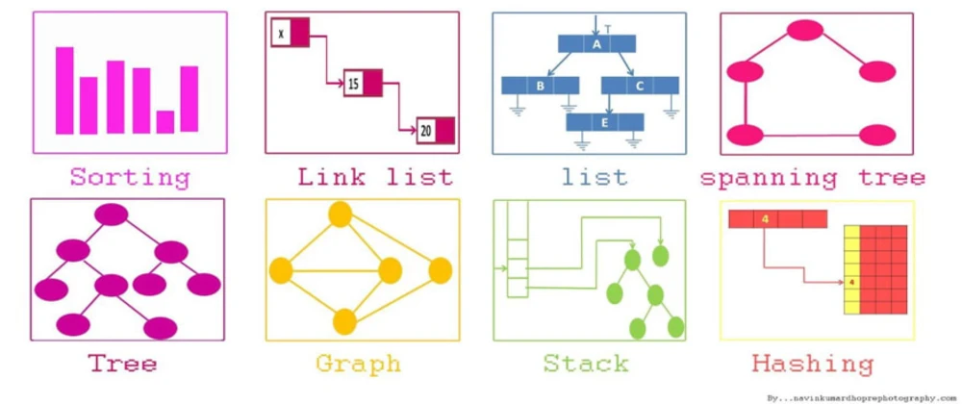
Caveat (early warning)!
You can only get the full advantage of Data Structures course if you have a good skill in PROGRAMMING!
C++

Slide 5
What do we in the Lab?
You will develop a skill to build concrete implementation of various data structures in C++ programming language
Data Structure
Linked List
ADT
Abstrat Data Type
Set ADT
Data Structure
Tree
Data Structure
Hashtable

Slide 6
How do we do it?
A worksheet
to work with
Weekly QUIZ (10 questions MCQ)
Solve problems
Submitted Solution
Code
to start with

Slide 7
Administrativia
Register in the COMP6571 Schoology course page
Signup as STUDENT on https://www.schoology.com/
Submit Lab Problem-set Solutions every week
Due every Saturday at 5 PM, one week after the Lab Session
Finish QUIZ every week
Due every Saturday at 5 PM, the Quiz open for one week
The Quiz STARTS in the 2nd Week
Access Code:
278J-C9MS-2VM5S

Slide 8





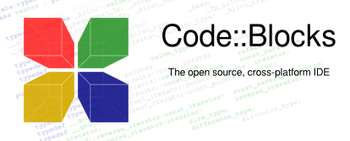
Tools for Lab Practice
Windows:
C++ Compilers
MinGW
GNU
Clang
Editor/IDE
MS Visual Studio 2019
MS Visual Studio Code
Sublime
Atom
Mac:
C++ Compilers
GNU
Editor/IDE
XCode
CLion
Sublime
Atom

Slide 9
Lab Worksheet for Week 1
Session 1: Creating simple C++ Programs
Session 2: Working with Arrays

Slide 10
